Slide 1

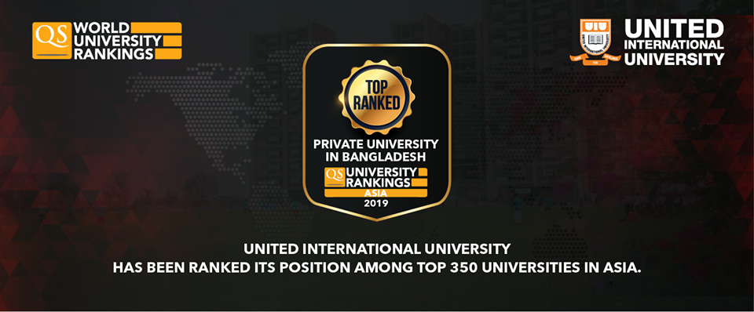
Cloud Computing CSE 487 -Introduction to Cloud Computing-
Prof. Dr. A.K.M. Muzahidul Islam
Computer Science & Engineering (CSE)
United International University (UIU)
Summer 2019

Slide 2
Course Outline: Summary
Topic 1: Introduction to Cloud Computing
Topic 2: Parallel and Distributed System
Topic 3: Cloud Infrastructure
Topic 4: Cloud Application
Topic 5: Virtualization
Topic 6: Cloud Security

Slide 3
About Me
Doctor of Engineering (Japanese Government Monbusho Scholarship) (04 Years)
Nagoya Institute of Technology (NiTech), Nagoya, Japan
Completed HSC (12 Years of Schooling)
Notre Dame College, Dhaka, Bangladesh
Completed MSc in Engineering (5-Year Russian Education System)
Kharkiv State of University of Radio Electronics, Kharkov, Ukraine
Completed University Foundadation Programme (01 Year)
Moscow State University of Railway and Engineering (MIIT), Moscow, Russia
1990
1992
1993
1994
1994
1999
2002
2007
Notes:
Before I move to my talk I would like to show my biography. …..

Slide 4
Senior Officer, IT Division
First Security Bank Ltd., Dhaka, Bangladesh
Professor
United International University (UIU)
Associate Professor & Head of CSE Department University of Liberal Arts Bangladesh (ULAB)
Senior Lecturer (Assistant Professor)
University Technology Malaysia (UTM)
Programmer & Network Engineering
Nagoya, Japan
~
2018
2018
2017
2017
2011
2010
2007
2002
1999
Notes:
Before I move to my talk I would like to show my biography. …..

Slide 5
Schedule
Section ‘A’
Wednesday
11:40 a.m.~ 1:30 p.m.
Room No. 0522 (Computer Lab 7)
Counseling
14:00 p.m.~ 15:30 p.m. (Wed)
Room No. 333/D (Level 3)

Slide 6
Assessment
Attendance : 5%
Assignments : 5%
Class Tests : 10%
Mid Term : 20%
Final : 40%
Project : 20%
Grading Policy
A (Plain) : 90-100 C+ (Plus) : 70-73
A- (Minus) : 86-89 C (Plain) : 66-69
B+ (Plus) : 82-85 C- (Minus) : 62-65
B (Plain) : 78-81 D+ (Plus) : 58-61
B- (Minus) : 74-77 D (Plain) : 55-57

Slide 7
Resources
Data Communications and Networking. Behrouz A. Forouzan
Data and Computer Communications. William Stallings (TENTH EDITION)

Slide 8
Outline
Introduction to Cloud
Introduction to Networking
Introduction to Networking

Slide 9
Overview
Why Cloud?
What is Cloud?
Service Models
Deployment Models
Cloud Providers

Slide 10
Why Cloud?
Before Cloud Computing:
Suppose you want to host a website, the following things that you need to do
Buy a stack of servers : Servers are usually very expensive, thus one end up paying a lot of money
Monitoring and Maintain Servers : Hire engineers or technicians to maintain the serves.
High Traffic, then install more serves : To handle higher data traffic it is required that extra devices are deployed.
Disadvantages
Setup is very expensive
Troubleshooting problems are tedious
Since traffic may vary, most of the time the server is idle

Slide 11
What is Cloud?
It has a huge space that is available online for usage
It is a collection of data centers that host application and store data
Make sure that one can manage all of his/her applications, recourses, etc. combining all data centers through a network and
Give you control to use these resources and mange them properly.

Slide 12
Cloud Computing
Uses Internet technologies to offer scalable and elastic services.
The term “elastic computing” refers to the ability of dynamically acquiring computing resources and supporting a variable workload.
The resources used for these services can be metered and
the users can be charged only for the resources they used.
The maintenance and security are ensured by service providers.
The service providers can operate more efficiently due to
specialization and centralization.

Slide 13
Cloud computing (cont’d)
Lower costs for the cloud service provider are past to the cloud users.
Data is stored:
closer to the site where it is used.
in a device and in a location-independent manner.
The data storage strategy can increase reliability, as well as security, and can lower communication costs.

Slide 14
Brief history
Is cloud Computing New?
Time Sharing: 1970s
Large Distributed Data Centers 1980s-1990s
Internet Computing 2000-Present
What is new in cloud computing today?
Faster data communication
Faster and more reliable computing
Denser and cheaper storage
Newer Programming paradigms
Comprehensive Computational resource sharing

Slide 15
Types of Clouds
Public Cloud - the infrastructure is made available to the general public or a large industry group and is owned by the organization selling cloud services.
Private Cloud – the infrastructure is operated solely for an organization.
Community Cloud - the infrastructure is shared by several organizations and supports a community that has shared concerns.
Hybrid Cloud - composition of two or more clouds (public, private, or community) as unique entities but bound by standardized technology that enables data and application portability.

Slide 16
The “good” about cloud computing
Resources, such as CPU cycles, storage, network bandwidth, are shared.
When multiple applications share a system, their peak demands for resources are not synchronized thus, multiplexing leads to a higher resource utilization.
Resources can be aggregated to support data-intensive applications.
Data sharing facilitates collaborative activities. Many applications require multiple types of analysis of shared data sets and multiple decisions carried out by groups scattered around the globe.

Slide 17
More “good” about cloud computing
Eliminates the initial investment costs for a private computing infrastructure and the maintenance and operation costs.
Cost reduction: concentration of resources creates the opportunity to pay as you go for computing.
Elasticity: the ability to accommodate workloads with very large peak-to-average ratios.
User convenience: virtualization allows users to operate in familiar environments rather than in idiosyncratic ones.

Slide 18
Why cloud computing could be successful when other paradigms have failed?
It is in a better position to exploit recent advances in software, networking, storage, and processor technologies promoted by the same companies who provide cloud services.
It is focused on enterprise computing; its adoption by industrial organizations, financial institutions, government, and so on could have a huge impact on the economy.
A cloud consists of a homogeneous set of hardware and software resources.
The resources are in a single administrative domain (AD). Security, resource management, fault-tolerance, and quality of service are less challenging than in a heterogeneous environment with resources in multiple ADs.

Slide 19
Challenges for cloud computing
Availability of service; what happens when the service provider cannot deliver?
Diversity of services, data organization, user interfaces available at different service providers limit user mobility; once a customer is hooked to one provider it is hard to move to another. Standardization efforts at NIST!
Data confidentiality and auditability, a serious problem.
Data transfer bottleneck; many applications are data-intensive.

Slide 20
More challenges
Performance unpredictability, one of the consequences of resource sharing.
How to use resource virtualization and performance isolation for QoS guarantees?
How to support elasticity, the ability to scale up and down quickly?
Resource management; are self-organization and self-management the solution?
Security and confidentiality; major concern.
Addressing these challenges provides good research opportunities!!

Slide 21
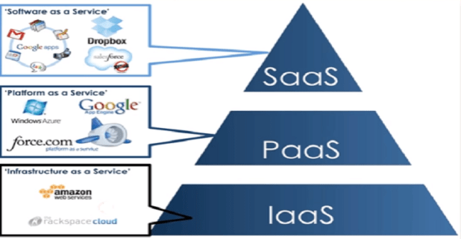
Cloud Delivery Models
Software as a Service (SaaS)
Platform as a Service (PaaS)
Infrastructure as a Service (IaaS)

Slide 22
Software-as-a-Service (SaaS)
Applications are supplied by the service provider.
The user does not manage or control the underlying cloud infrastructure or individual application capabilities.
Services offered include:
Enterprise services such as: workflow management, group-ware and collaborative, supply chain, communications, digital signature, customer relationship management (CRM), desktop software, financial management, geo-spatial, and search.
Web 2.0 applications such as: metadata management, social networking, blogs, wiki services, and portal services.
Not suitable for real-time applications or for those where data is not allowed to be hosted externally.
Examples: Gmail, Google search engine.

Slide 23
Platform-as-a-Service (PaaS)
Allows a cloud user to deploy consumer-created or acquired applications using programming languages and tools supported by the service provider.
The user:
Has control over the deployed applications and, possibly, application hosting environment configurations.
Does not manage or control the underlying cloud infrastructure including network, servers, operating systems, or storage.
Not particularly useful when:
The application must be portable.
Proprietary programming languages are used.
The hardware and software must be customized to improve the performance of the application.

Slide 24
Infrastructure-as-a-Service (IaaS)
The user is able to deploy and run arbitrary software, which can include operating systems and applications.
The user does not manage or control the underlying cloud infrastructure but has control over operating systems, storage, deployed applications, and possibly limited control of some networking components, e.g., host firewalls.
Services offered by this delivery model include: server hosting, Web servers, storage, computing hardware, operating systems, virtual instances, load balancing, Internet access, and bandwidth provisioning.

Slide 25
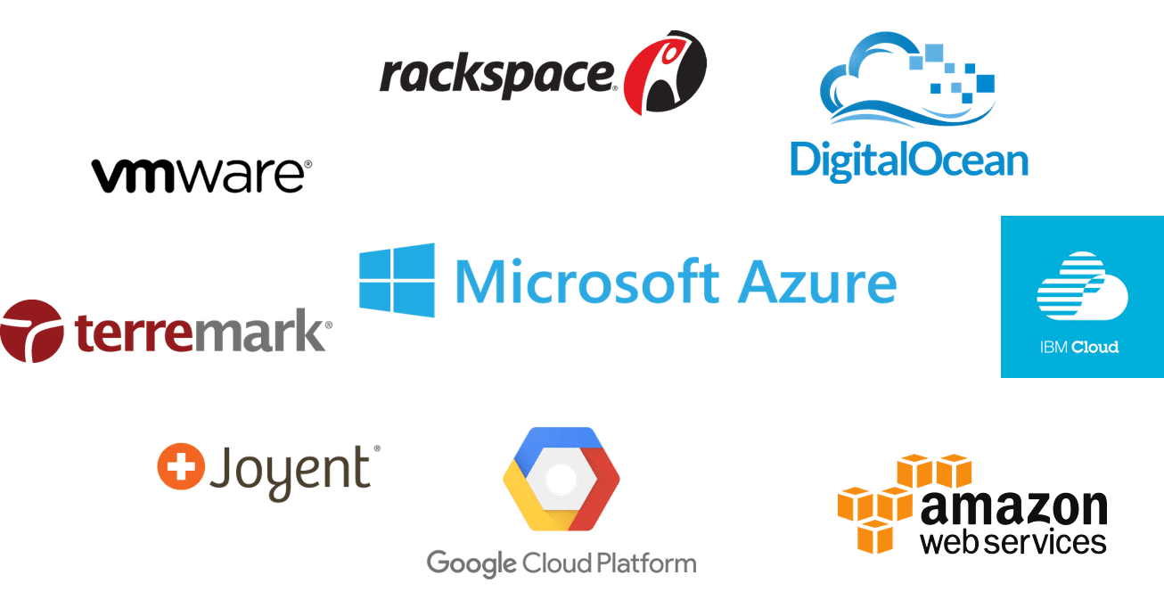
Cloud Providers

Slide 26
Cloud activities
Service management and provisioning including:
Virtualization.
Service provisioning.
Call center.
Operations management.
Systems management.
QoS management.
Billing and accounting, asset management.
SLA management.
Technical support and backups.

Slide 27
Cloud activities (cont’d)
Security management including:
ID and authentication.
Certification and accreditation.
Intrusion prevention.
Intrusion detection.
Virus protection.
Cryptography.
Physical security, incident response.
Access control, audit and trails, and firewalls.

Slide 28
Cloud activities (cont’d)
Customer services such as:
Customer assistance and on-line help.
Subscriptions.
Business intelligence.
Reporting.
Customer preferences.
Personalization.
Integration services including:
Data management.
Development.

Slide 29


Slide 30
Network-centric computing
Information processing can be done more efficiently on large farms of computing and storage systems accessible via the Internet.
Grid computing – initiated by the National Labs in the early 1990s; targeted primarily at scientific computing.
Utility computing – initiated in 2005-2006 by IT companies and targeted at enterprise computing.
Grid computing is distributed system, a large number of loosely coupled, heterogeneous, and geographically dispersed systems in different administrative domains. The term grid computing is a metaphor of electric grid.
The focus of utility computing is on the business model for providing computing services; it often requires a cloud-like infrastructure.
Cloud computing is a path to utility computing embraced by major IT companies including: Amazon, HP, IBM, Microsoft, Oracle, and others.

Slide 31
Network-centric content
Content: any type or volume of media, be it static or dynamic, monolithic or modular, live or stored, produced by aggregation, or mixed.
The “Future Internet” will be content-centric.
The creation and consumption of audio and visual content is likely to transform the Internet to support increased quality in terms of resolution, frame rate, color depth, stereoscopic information.

Slide 32
Network-centric computing and content
Data-intensive: large scale simulations in science and engineering require large volumes of data. Multimedia streaming transfers large volume of data.
Network-intensive: transferring large volumes of data requires high bandwidth networks.
Low-latency networks for data streaming, parallel computing, computation steering.
The systems are accessed using thin clients (e.g., Google Chrome OS) running on systems with limited resources, e.g., wireless devices such as smart phones and tablets.
The infrastructure should support some form of workflow management, i.e., complex computational tasks require coordination of several applications

Slide 33
Advantages of Network-centric computing and content
Computing and communication resources (CPU cycles, storage, network bandwidth) are shared and resources can be aggregated to support data-intensive applications
Data sharing facilitates collaborative activities
Cost reduction: pay as you go model, eliminate initial investment, reduces significantly maintenance and operation costs
User convenience and elasticity, accommodate very large peak-to-average ratios

Slide 34
Evolution of concepts and technologies
The concepts and technologies for network-centric computing and content evolved along the years.
The web and the semantic web - expected to support composition of services. The web is dominated by unstructured or semi-structured data, while the semantic web advocates inclusion of sematic content in web pages.
The Grid - initiated in the early 1990s by National Laboratories and Universities; used primarily for applications in the area of science and engineering.
Peer-to-peer systems.
Computer clouds.

Slide 37
NIST cloud reference model

Slide 38
Ethical issues
Paradigm shift with implications on computing ethics:
The control is relinquished to third party services.
The data is stored on multiple sites administered by several organizations.
Multiple services interoperate across the network.
Implications
Unauthorized access.
Data corruption.
Infrastructure failure, and service unavailability.

Slide 39
De-perimeterisation
Systems can span the boundaries of multiple organizations and cross the security borders.
The complex structure of cloud services can make it difficult to determine who is responsible in case something undesirable happens.
Identity fraud and theft are made possible by the unauthorized access to personal data in circulation and by new forms of dissemination through social networks and they could also pose a danger to cloud computing.

Slide 40
Privacy issues
Cloud service providers have already collected petabytes of sensitive personal information stored in data centers around the world. The acceptance of cloud computing therefore will be determined by privacy issues addressed by these companies and the countries where the data centers are located.
Privacy is affected by cultural differences; some cultures favor privacy, others emphasize community. This leads to an ambivalent attitude towards privacy in the Internet which is a global system.

Slide 41
Cloud vulnerabilities
Clouds are affected by malicious attacks and failures of the infrastructure, e.g., power failures.
Such events can affect the Internet domain name servers and prevent access to a cloud or can directly affect the clouds:
in 2004 an attack at Akamai caused a domain name outage and a major blackout that affected Google, Yahoo, and other sites.
in 2009, Google was the target of a denial of service attack which took down Google News and Gmail for several days;
in 2012 lightning caused a prolonged down time at Amazon.

Slide 42
Thank You

